Slide 1







Language to learn: Preparing for the future in programming
Dustin Ober
April 2, 2023

Slide 2



OUTLINE
Executive Summary
Introduction
Methodology
Results
Visualization – Charts
Dashboard
Discussion
Findings & Implications
Conclusion
Appendix

Slide 3

EXECUTIVE SUMMARY
Trends in current technology usage:
Programming languages
Databases
Platforms
Web frameworks
Emerging technology trends:
Programming languages
Databases
Platforms
Web frameworks
Demographic survey:
Differences in technology usage and access based on country and gender.

Slide 4

INTRODUCTION
Title: Analysis of Technology Trends in Software and Web Development Among Developers Worldwide
Objective:
To analyze current technology trends in software and web development worldwide.
To identify the most in-demand programming languages, databases, platforms, and web frameworks.
To identify the skills that will be required in the future.
To identify gaps in the availability of human resources within the industry.
Target audience:
Programmers
IT industry leaders
Computer science students

Slide 5

METHODOLOGY
Data Collection (Sources)
Stack overflow developer 2019 survey
GitHub job postings
Programming languages annual salary
Data Wrangling
Data Exploration
Data Cleaning
Data Visualization
Python matplotlib & turtle
IBM Cognos
Presentation

Slide 6
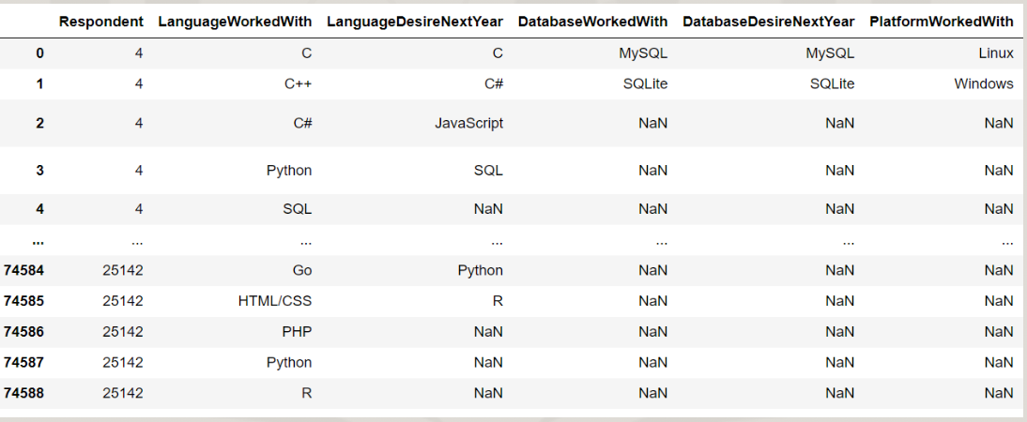
RESULTS

Slide 7
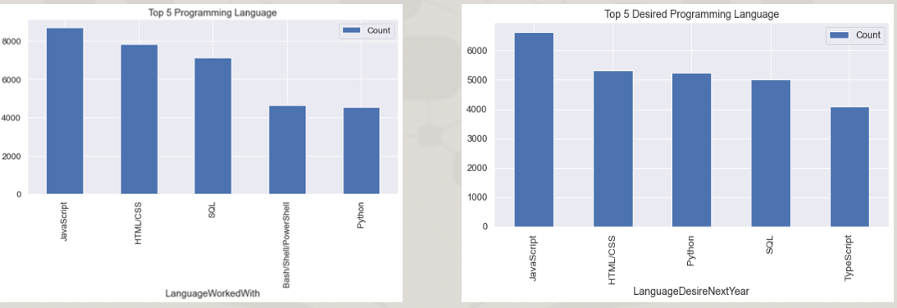
PROGRAMMING LANGUAGE TRENDS
Current Year
Next Year

Slide 8
PROGRAMMING LANGUAGE TRENDS - FINDINGS & IMPLICATIONS
Findings
JavaScript remains the most popular programming language in the world.
Python and TypeScript are rapidly increasing in popularity.
HTML/CSS and SQL continue to be widely used and maintain a significant portion of the language usage trend.
Implications
The demand for web development and web developers remains high.
For developers, it is crucial to learn JavaScript and TypeScript.
Python is an increasingly popular language, particularly in the field of artificial intelligence.

Slide 9
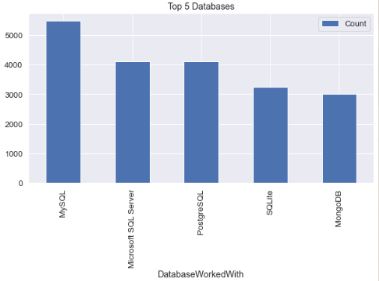
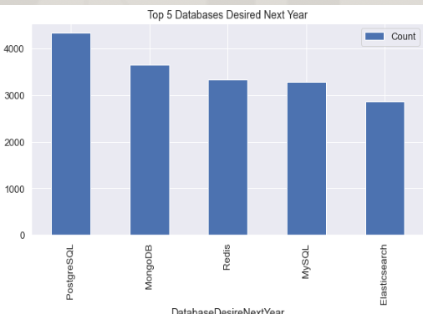
DATABASE TRENDS
Current Year
Next Year

Slide 10
DATABASE TRENDS - FINDINGS & IMPLICATIONS
Findings
MySQL continues to be the most widely used database.
Many companies still rely on Microsoft SQL Server for their database needs.
MongoDB and Redis are among the most popular NoSQL databases.
Implications
Open-source databases such as MySQL continue to be a preferred choice for many users.
SQL is still essential for software development and big data technologies.
NoSQL databases are increasingly gaining importance and have the potential to complement or replace relational databases in certain use cases.

Slide 11

DASHBOARD
https://dataplatform.cloud.ibm.com/dashboards/67d03f66-952c-4791-b413-a64ce28b68a3/view/0764d92b64f137fc43f7d4e407c87a0f283e775be0bbd652d48c7b490f342797a8694790c8294b0eda130463f7eb1a5ec1

Slide 12
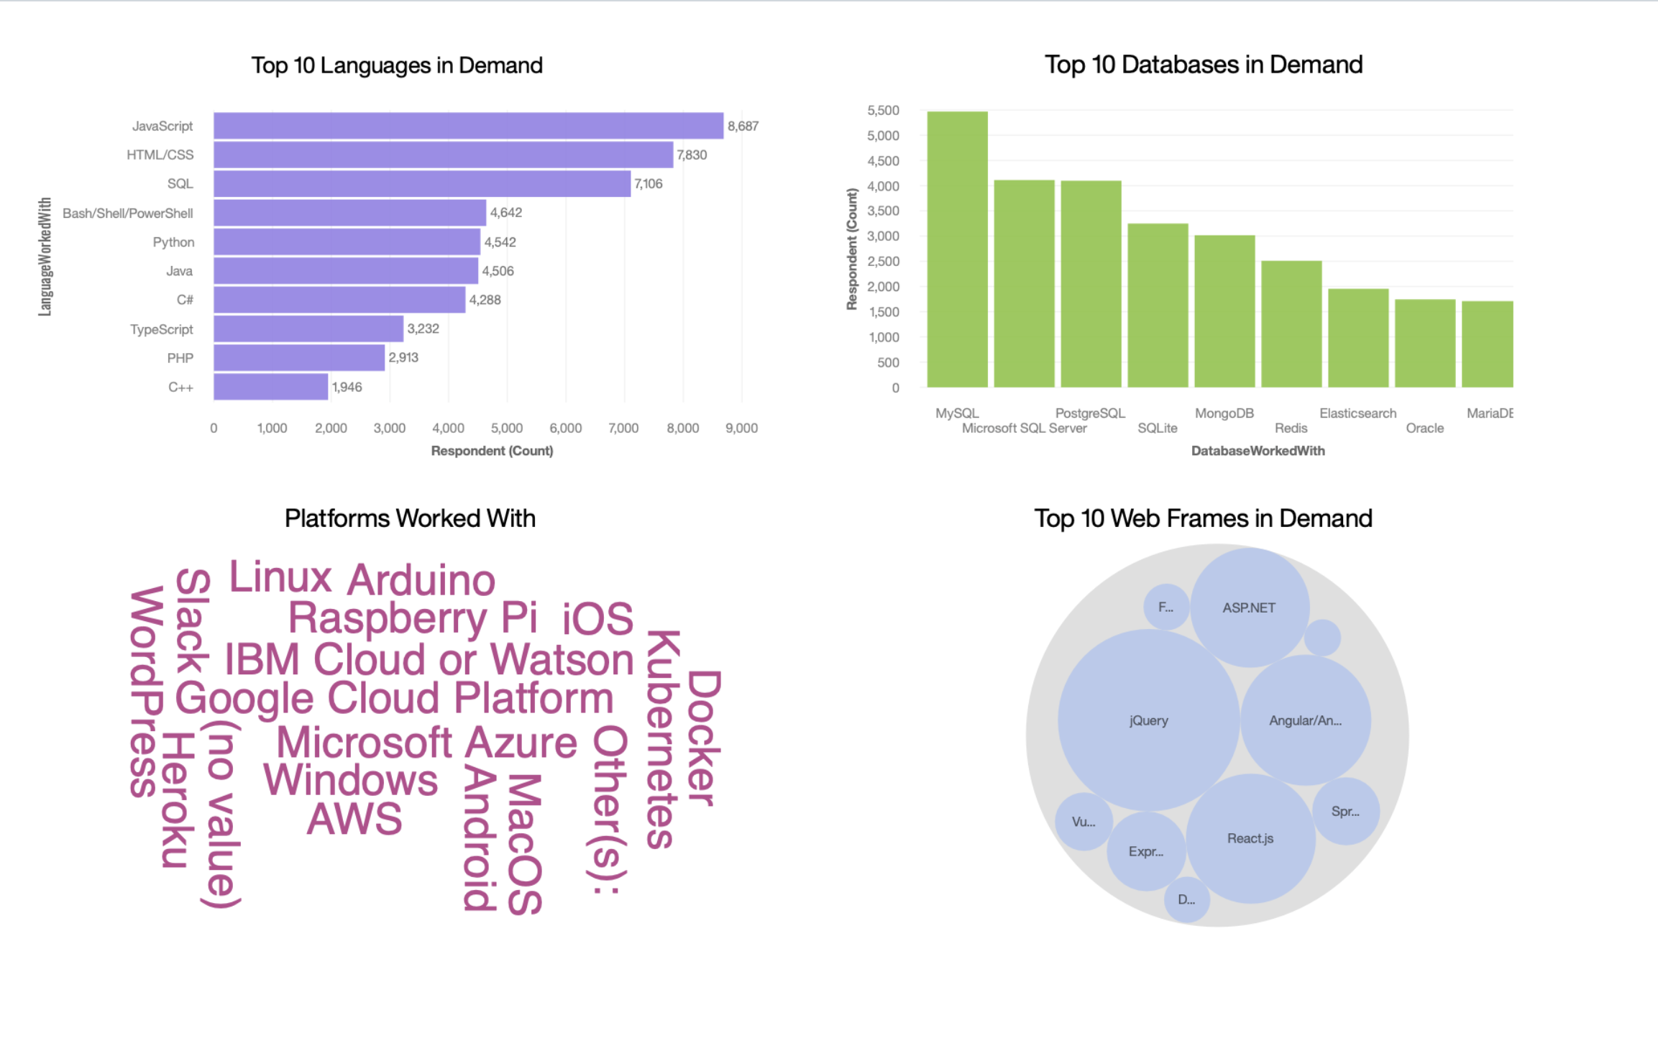
DASHBOARD TAB 1

Slide 13
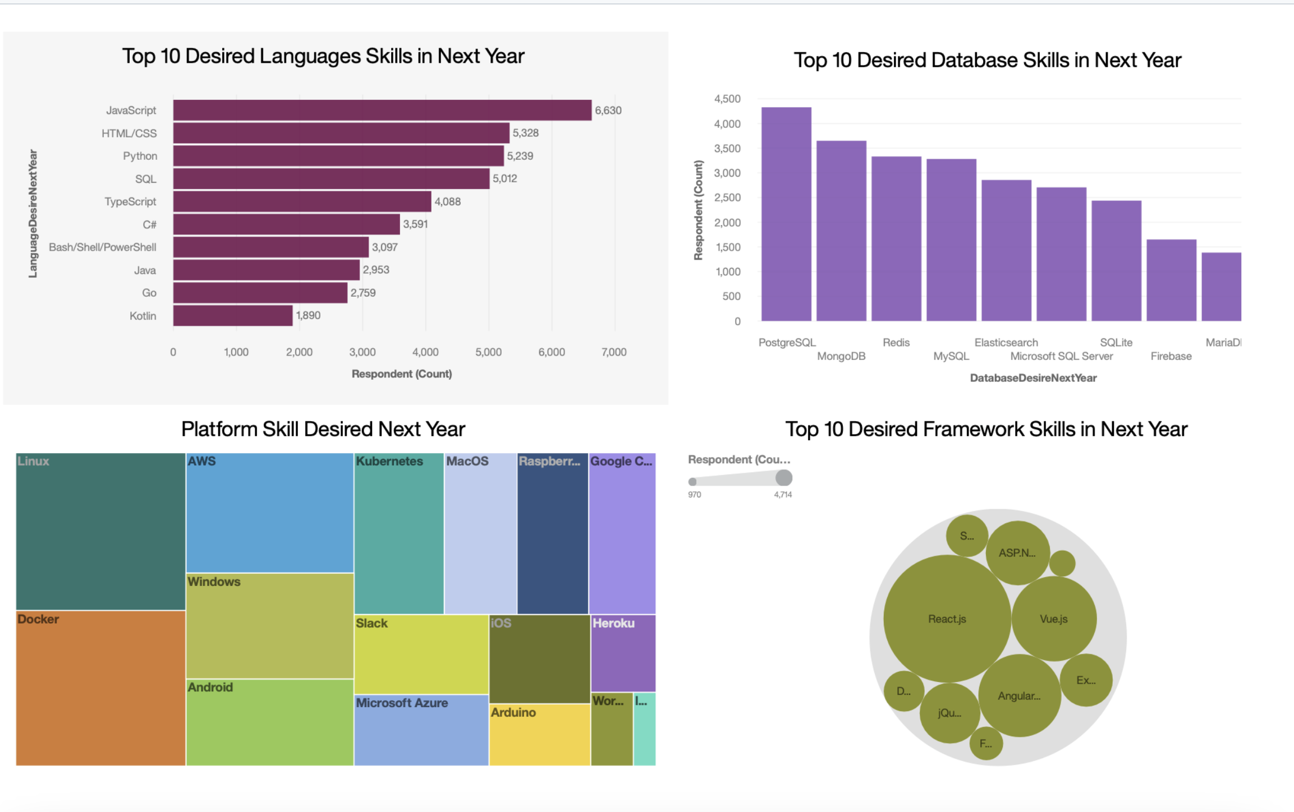
DASHBOARD TAB 2

Slide 14
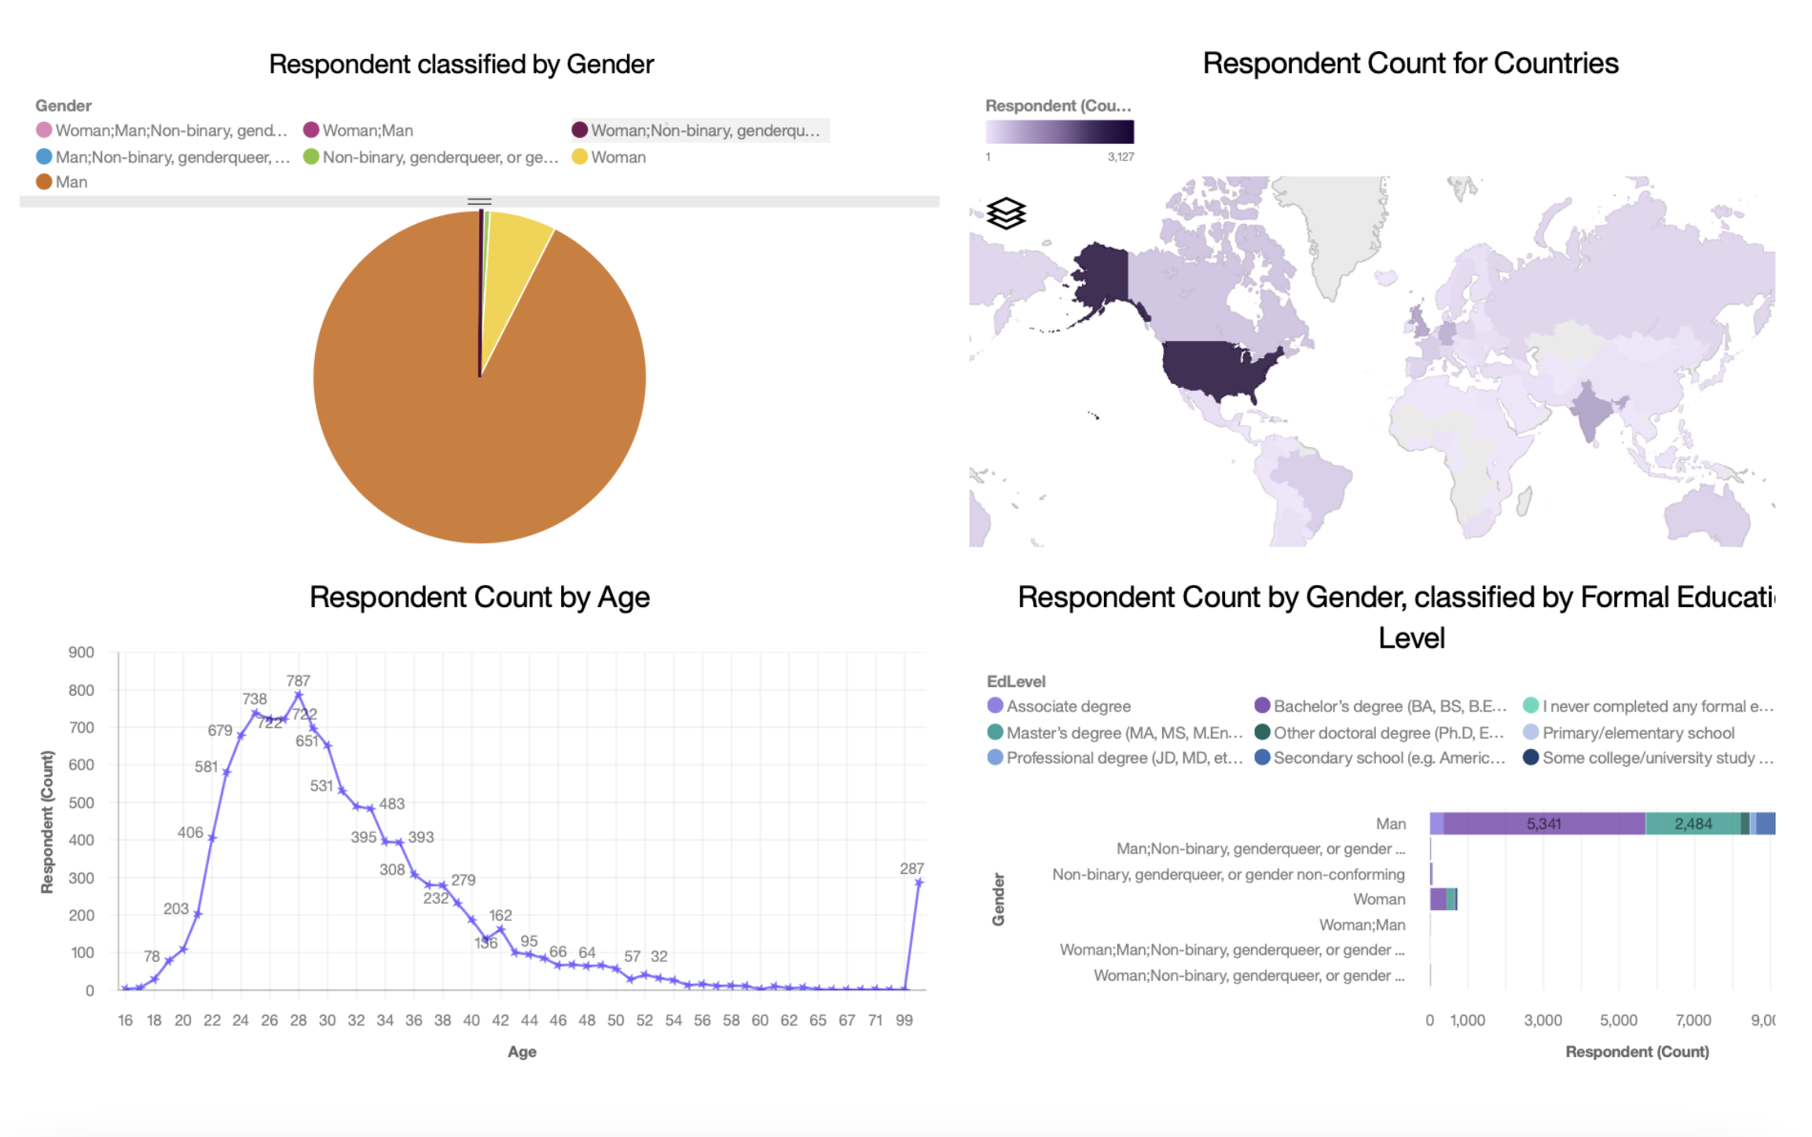
DASHBOARD TAB 3

Slide 15
DISCUSSION
Current and Future Trends in Technology Usage
Discrimination in the IT Industry Based on Gender, Age, and Education

Slide 16
OVERALL FINDINGS & IMPLICATIONS
Findings
Technology trends are constantly changing every year.
The United States is a leading technology country.
There is significant discrimination in the technology industry based on gender and age.
Docker and AWS are among the most widely used platforms.
Implications
It is important for programmers to keep up with the latest technology trends.
More countries should have equal opportunities to access and adopt new technologies.
Employment decisions should not be based on an individual's gender or age.

Slide 17

CONCLUSION
Trends in Technology
Trends in Programming Languages, Databases, Platforms, and Web Frameworks
Trends in Demographics
Gender and Education Trends
Trends in Programming Languages and Salary Trends

Slide 18

APPENDIX
IBM Cognos Dashboard Embedded (CDE) is a business intelligence service powered by artificial intelligence that supports the entire data analytics process, from discovery to operationalization. It offers users data discovery capabilities to visually explore and interact with their data, enabling them to identify key insights for making data-driven decisions. With CDE, users can easily assemble information into interactive and visually appealing dashboards, without requiring formal training.

Slide 19
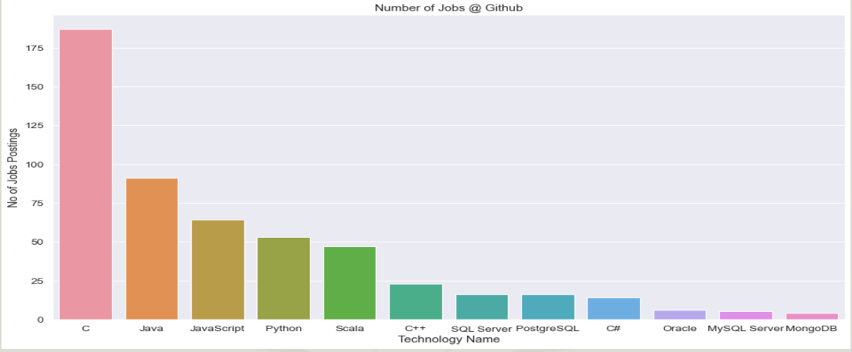
JOB POSTINGS

Slide 20
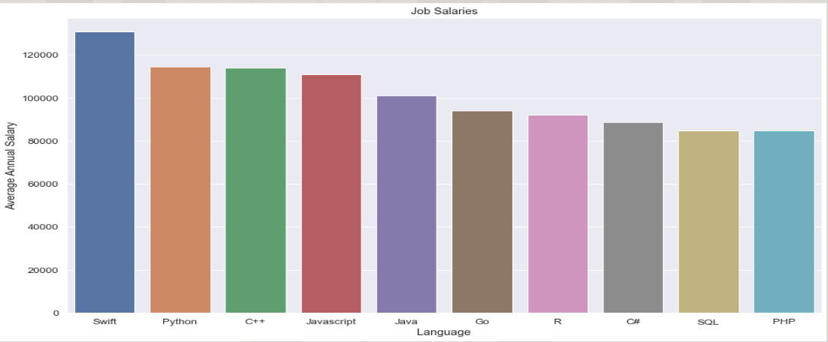
POPULAR LANGUAGES

